Slide 1
Medical sciences education: Websites, journals and valid & reliable sources
Dr Ghaffarifar S, M.D, M.M.Ed, D.H.E.P
Associate professor of Medical Education
Tabriz University of Medical Sciences

Slide 2
In this short presentation:
We will briefly review:
The websites
Journals
Databases
Other valid& reliable resources
in medical sciences education

Slide 3
https://eric.ed.gov/

Slide 4
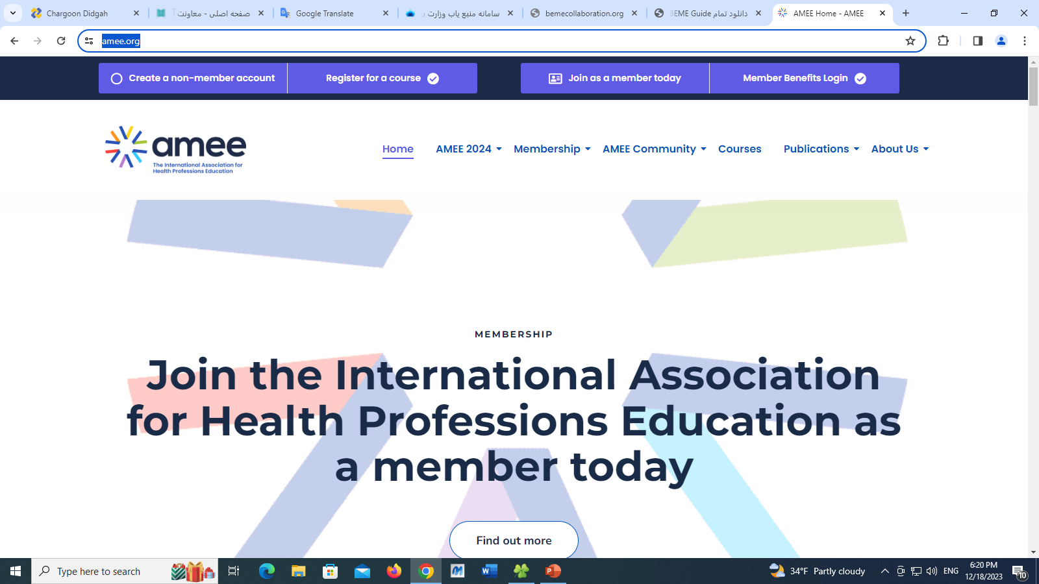
https://amee.org/

Slide 5
AMEE guide

Slide 6
AMEE guides

Slide 7
The Best Evidence Medical Education (BEME) Collaboration

Slide 8
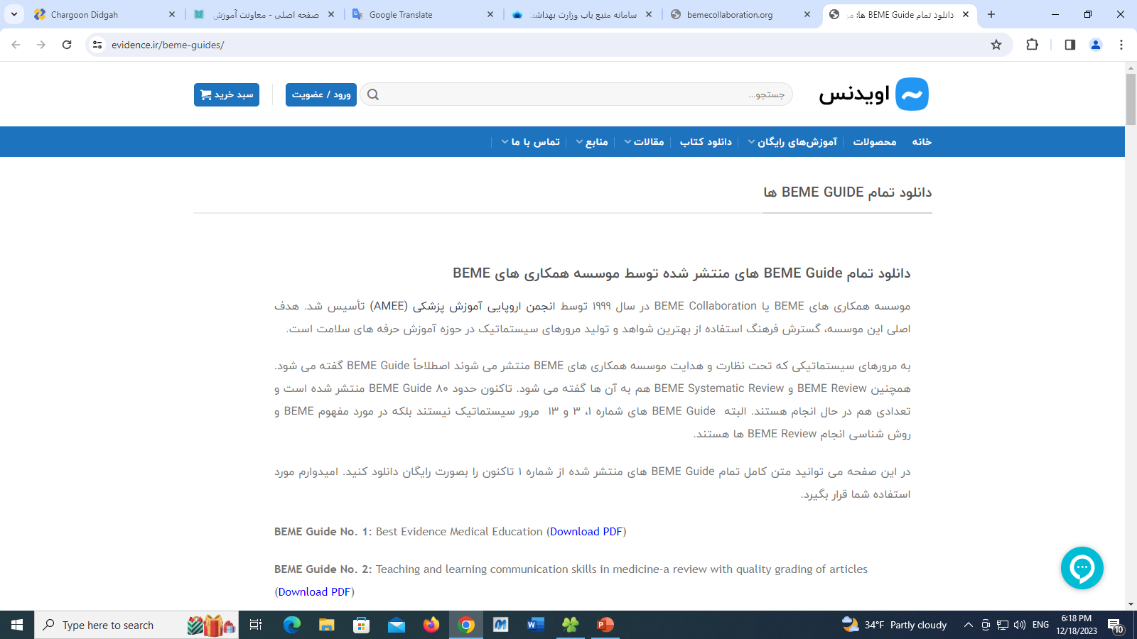
https://evidence.ir/beme-guides/

Slide 9
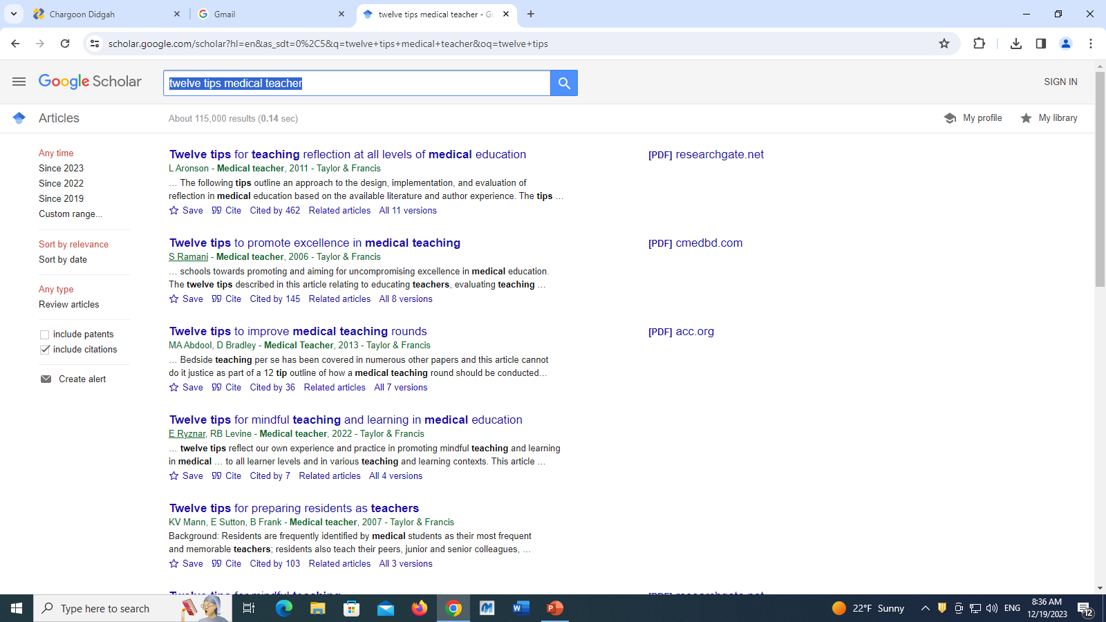
Twelve tips medical teacher

Slide 10
scoping review

Slide 11
scoping review protocol

Slide 12
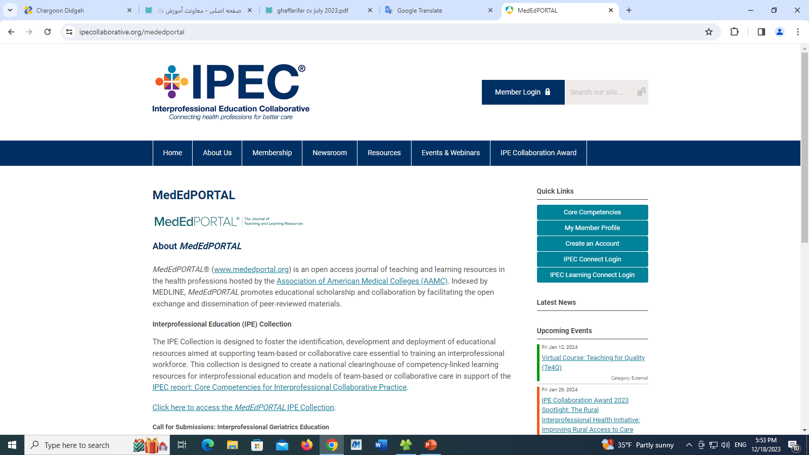
https://www.ipecollaborative.org/mededportal

Slide 13
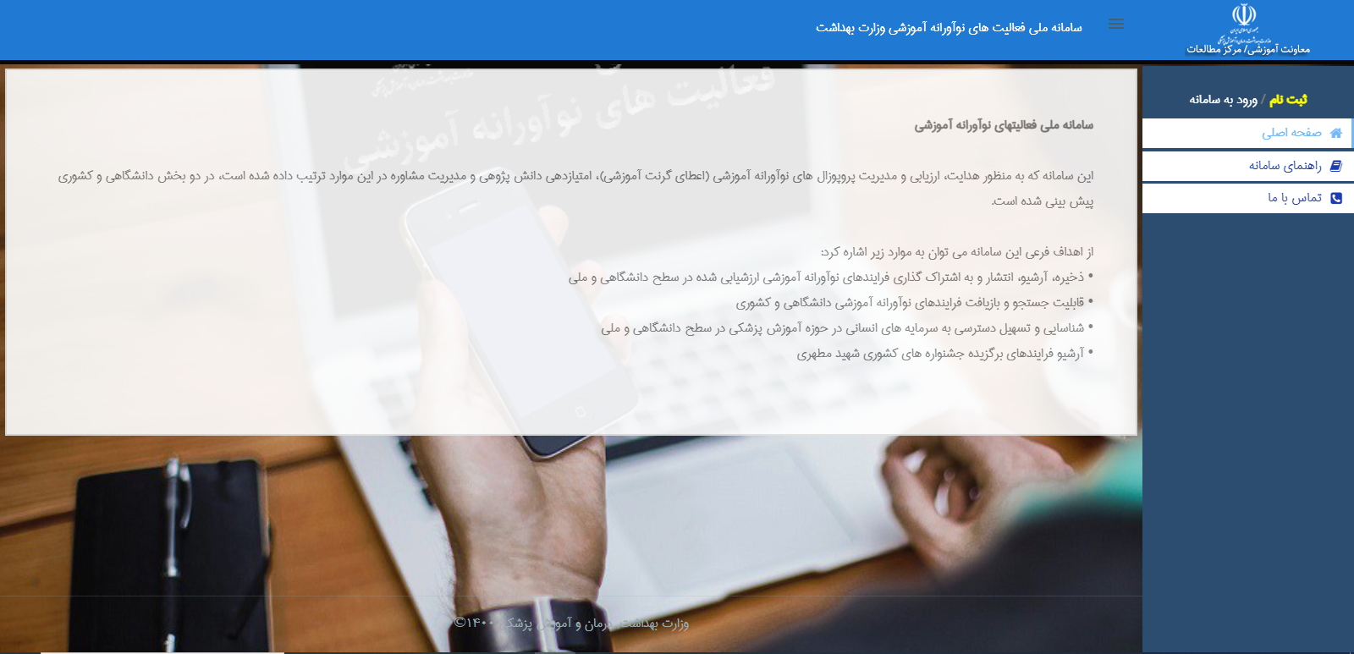
http://meded1.behdasht.gov.ir/

Slide 14
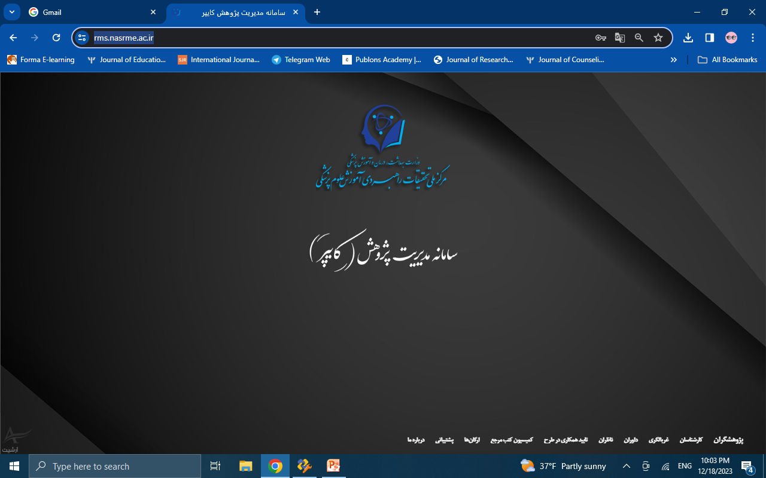
https://rms.nasrme.ac.ir/

Slide 15
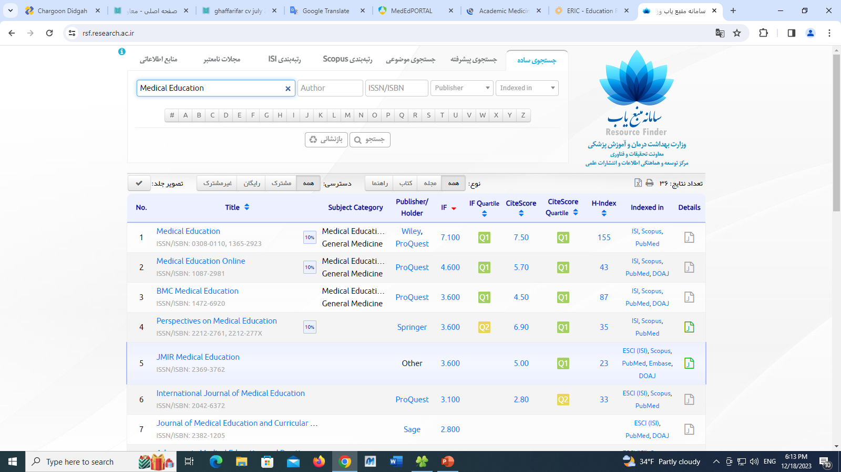
https://rsf.research.ac.ir/

Slide 16
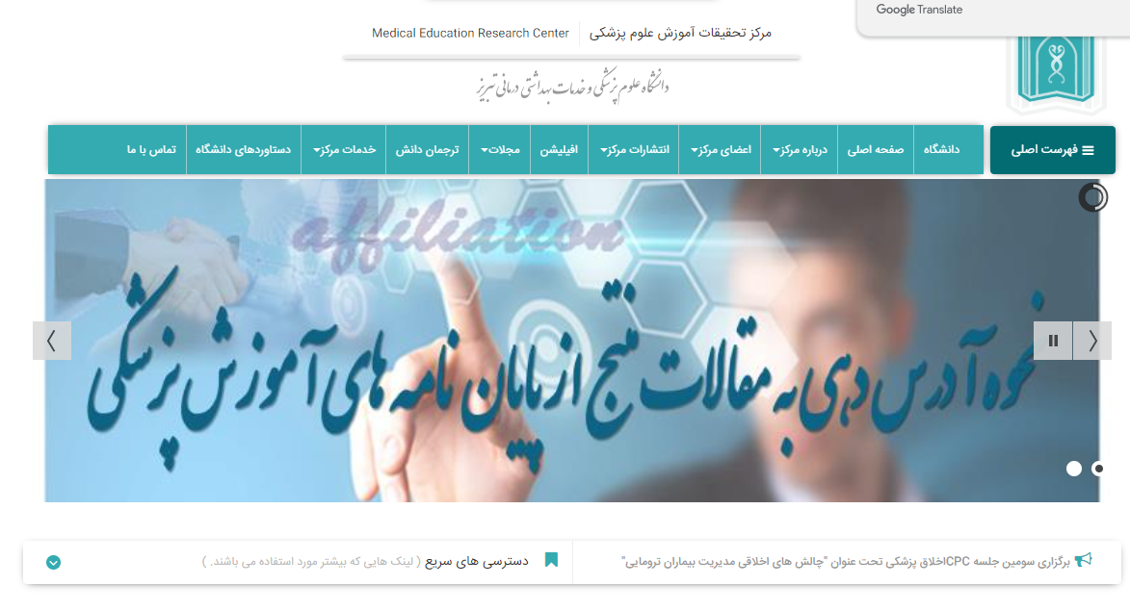
https://merc.tbzmed.ac.ir/

Slide 17
https://merc.tbzmed.ac.ir/?PageID=16

Slide 18
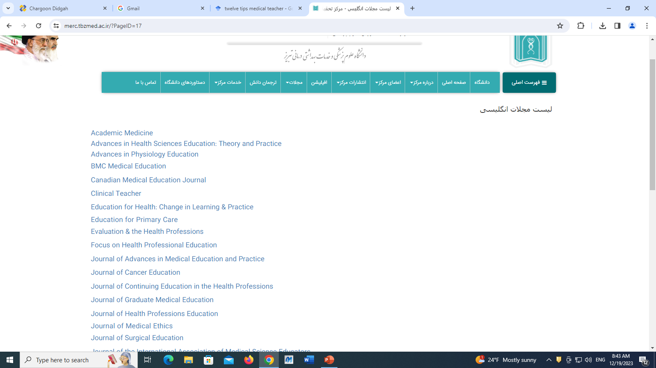
https://merc.tbzmed.ac.ir/?PageID=17

Slide 19
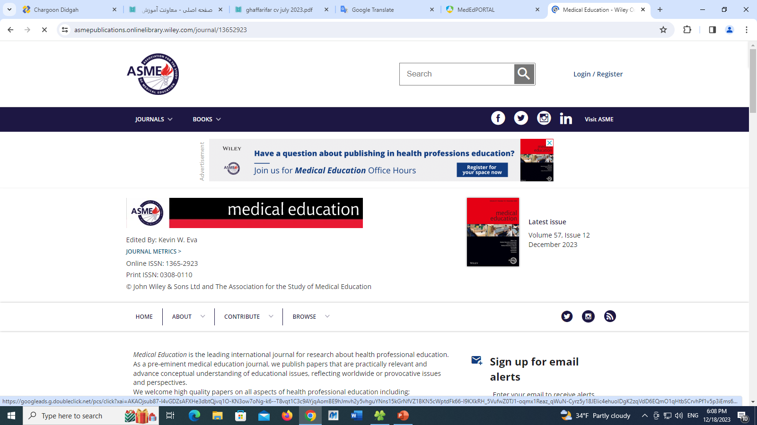
https://asmepublications.onlinelibrary.wiley.com/journal/13652923

Slide 20
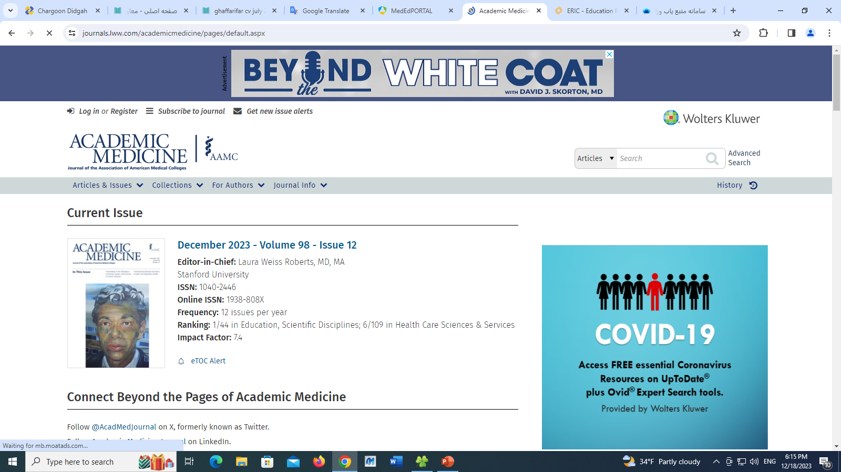
https://journals.lww.com/academicmedicine/pages/default.aspx

Slide 21
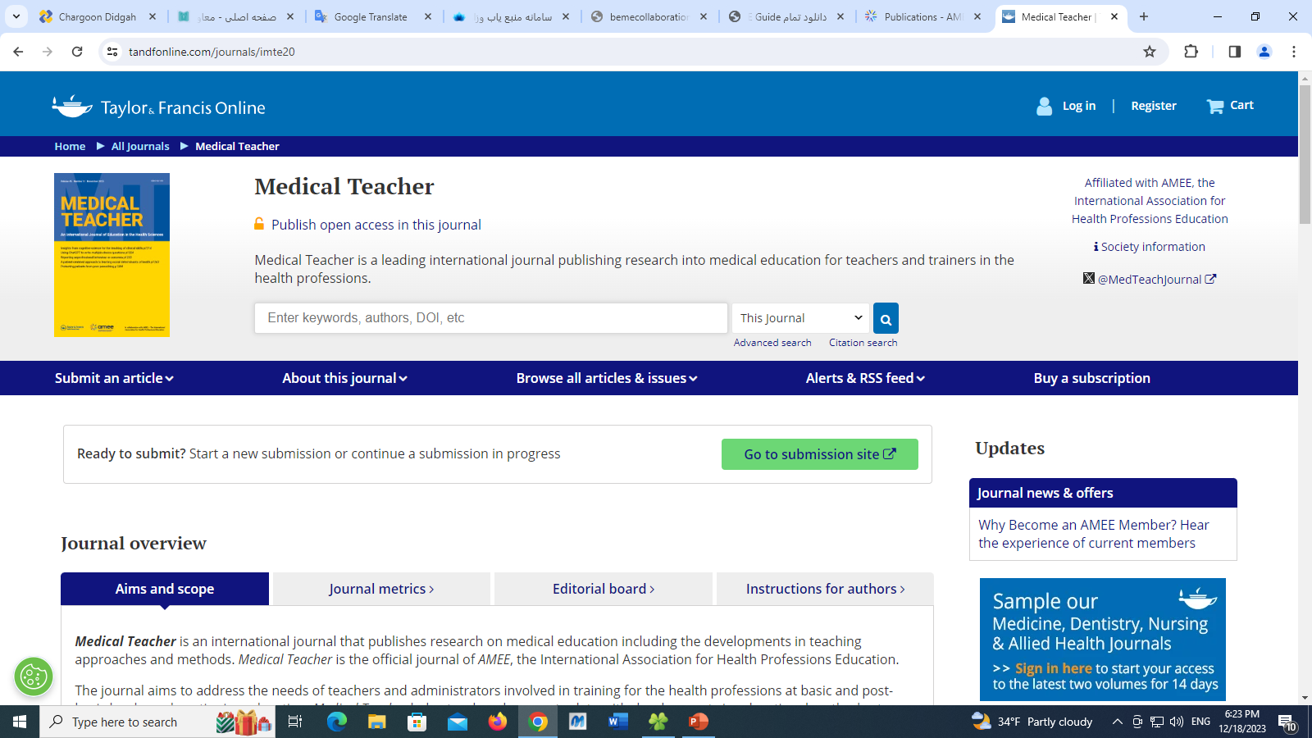
https://www.tandfonline.com/journals/imte20

Slide 22
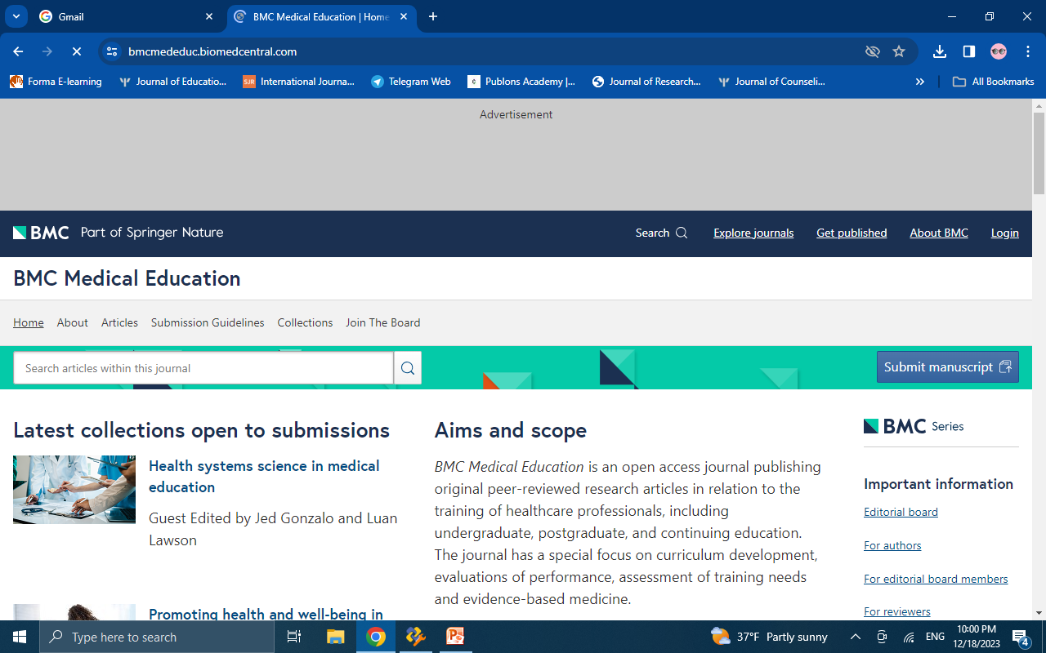
https://bmcmededuc.biomedcentral.com/

Slide 23
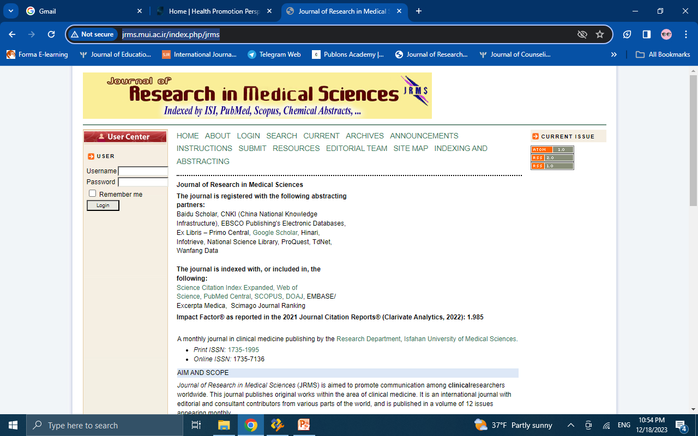
http://jrms.mui.ac.ir/index.php/jrms

Slide 24
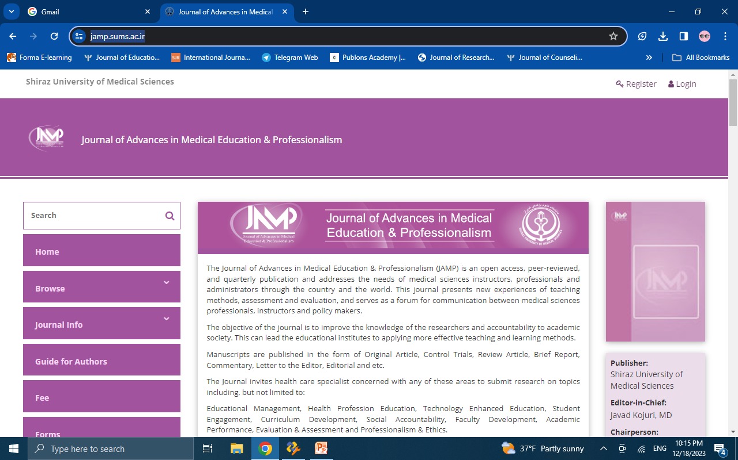
https://jamp.sums.ac.ir/

Slide 25
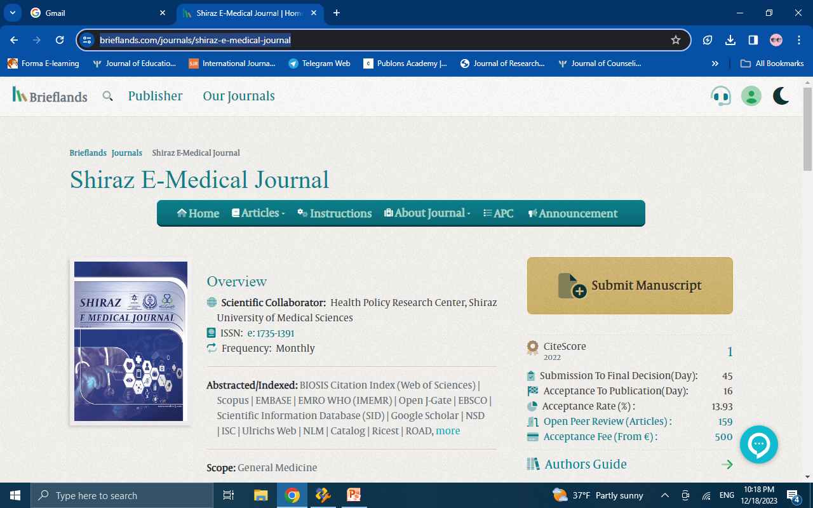
https://brieflands.com/journals/shiraz-e-medical-journal

Slide 26
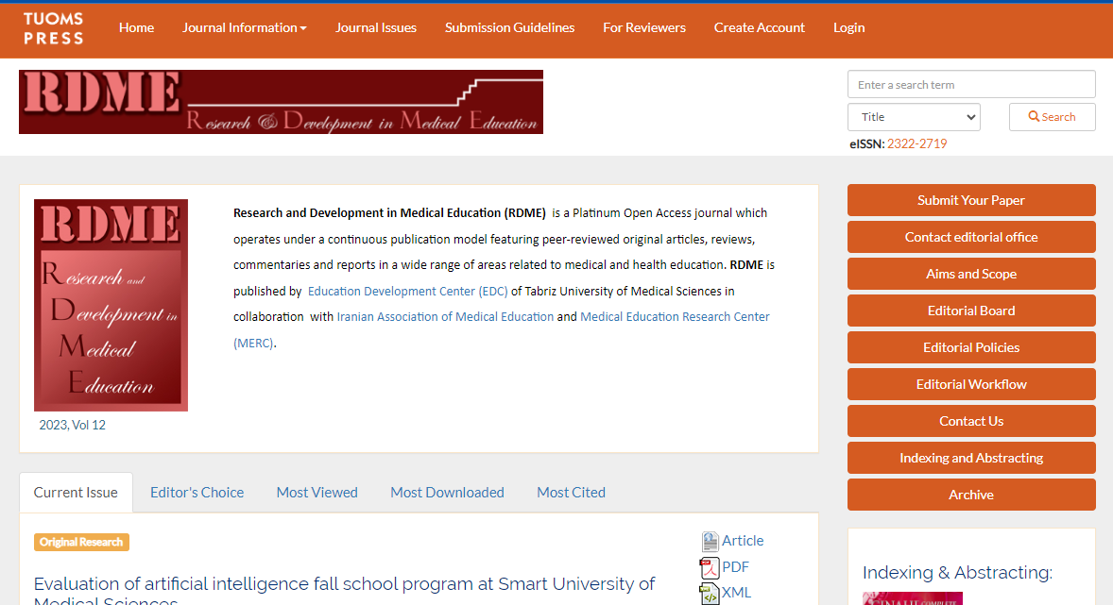
https://rdme.tbzmed.ac.ir/

Slide 27
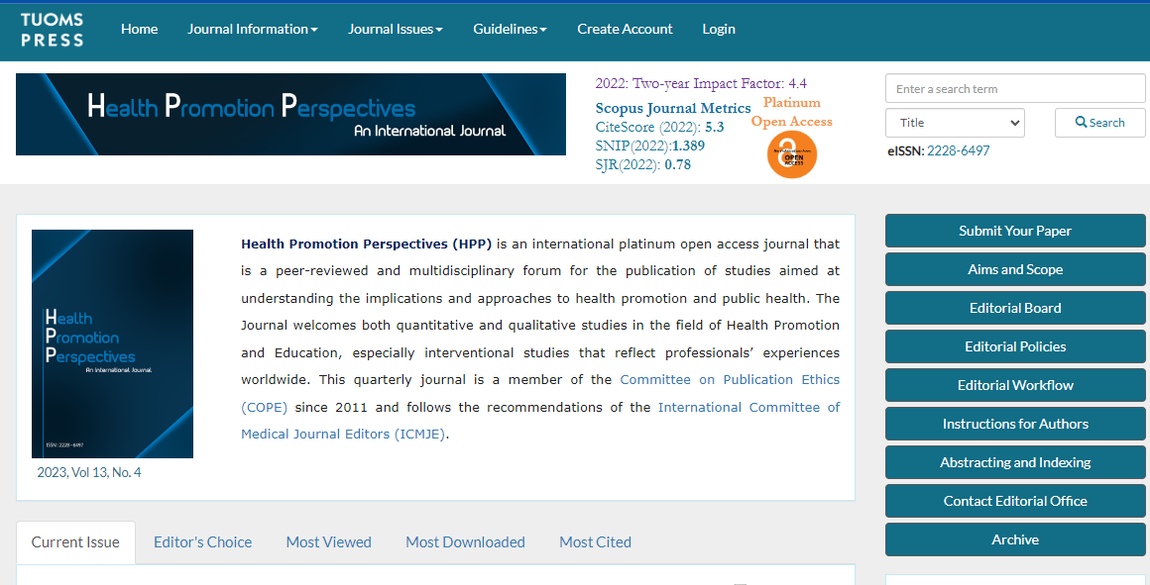
https://hpp.tbzmed.ac.ir/

Slide 28
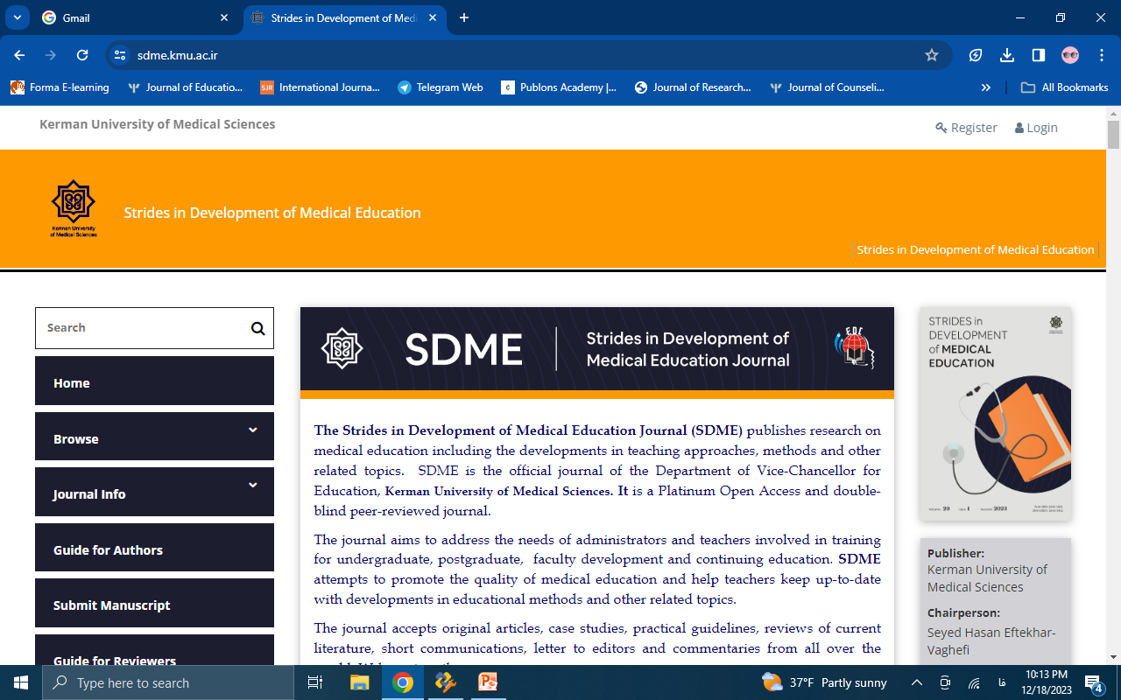
https://sdme.kmu.ac.ir/

Slide 29
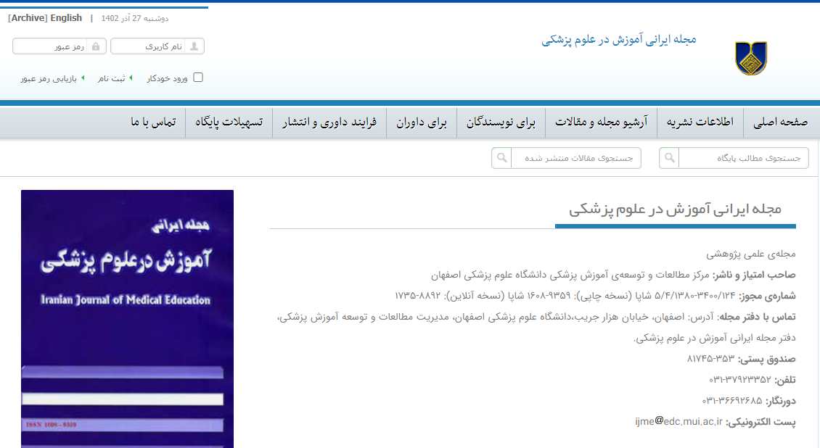
https://ijme.mui.ac.ir/

Slide 30
SUMMARY
Let's summarize collaboratively
…
...
...

Slide 31
THANK YOU
ghaffarifars@tbzmed.ac.ir
sa.ghafarifar@gmail.com
https://edc.tbzmed.ac.ir/uploads/user/56/cv/ghaffarifar%20cv%20july%202023.pdf
https://www.scopus.com/authid/detail.uri?authorId=55303918500

